Slide 1
Javascript Objects
Dr. Swarna Priya RM

Slide 2
JavaScript Objects
Objects not Classes
JavaScript is not a full-fledged object-oriented programming language.
It does not have classes per se, and it does not support many of the patterns you’d expect from an object-oriented language like inheritance and polymorphism.
The language does, however, support objects.

Slide 3
JavaScript Objects
Not full-fledged O.O.
Objects can have constructors, properties, and methods associated with them.
There are objects that are included in the JavaScript language; you can also define your own kind of objects.

Slide 4
Constructors
Normally to create a new object we use the new keyword, the class name, and ( ) brackets with n optional parameters inside, comma delimited as follows:
var someObject = new ObjectName(p1,p2,..., pn); For some classes, shortcut constructors are defined var greeting = "Good Morning";
vs the formal:
var greeting = new String("Good Morning");

Slide 5
Properties
Use the dot
Each object might have properties that can be accessed, depending on its definition.
When a property exists, it can be accessed using dot notation where a dot between the instance name and the property references that property.
//show someObject.property to the user
alert(someObject.property);

Slide 6
Methods
Use the dot, with brackets
Objects can also have methods, which are functions associated with an instance of an object. These methods are called using the same dot notation as for properties, but instead of accessing a variable, we are calling a method.
someObject.doSomething();
Methods may produce different output depending on the object they are associated with
because they can utilize the internal properties of the object.

Slide 7
Objects Included in JavaScript
A number of useful objects are included with JavaScript including:
Array
Boolean
Date
Math
String
Dom objects

Slide 8
Arrays
Arrays are one of the most used data structures. In practice, this class is defined to behave more like a linked list in that it can be resized dynamically, but the implementation is browser specific, meaning the efficiency of insert and delete operations is unknown.
The following code creates a new, empty array named greetings:
var greetings = new Array();

Slide 9
Arrays
Initialize with values
To initialize the array with values, the variable declaration would look like the following:
var greetings = new Array("Good Morning", "Good Afternoon"); or, using the square bracket notation:
var greetings = ["Good Morning", "Good Afternoon"];

Slide 10
Arrays
Access and Traverse
To access an element in the array you use the familiar square bracket notation from Java and C-style languages, with the index you wish to access inside the brackets.
alert ( greetings[0] );
One of the most common actions on an array is to traverse through the items sequentially.
Using the Array object’s length property to determine the maximum valid index. We have:
for (var i = 0; i < greetings.length; i++){ alert(greetings[i]);
}

Slide 11
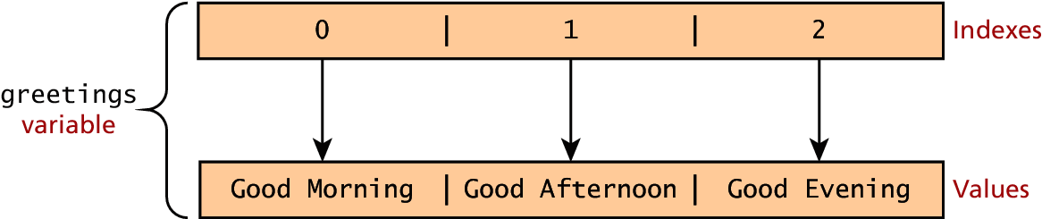
Arrays
Index and Value

Slide 12
Arrays
Modifying an array
To add an item to an existing array, you can use the push method. greetings.push("Good Evening");
The pop method can be used to remove an item from the back of an array.
Additional methods: concat(), slice(), join(), reverse(), shift(), and sort()

Slide 13
Math
The Math class allows one to access common mathematic functions and common values quickly in one place.
This static class contains methods such as max(), min(), pow(), sqrt(), and exp(), and trigonometric functions such as sin(), cos(), and arctan().
Many mathematical constants are defined such as PI, E, SQRT2, and some others
Math.PI; // 3.141592657
Math.sqrt(4); // square root of 4 is 2.
Math.random(); // random number between 0 and 1

Slide 14
String
The String class has already been used without us even knowing it.
Constructor usage
var greet = new String("Good"); // long form constructor
var greet = "Good"; // shortcut constructor
Length of a string
alert (greet.length); // will display "4"

Slide 15
String
Concatenation and so much more
var str = greet.concat("Morning"); // Long form concatenation
var str = greet + "Morning"; // + operator concatenation
Many other useful methods exist within the String class, such as
accessing a single character using charAt()
searching for one using indexOf().
Strings allow splitting a string into an array, searching and matching with split(), search(), and match() methods.

Slide 16
Date
It allows you to quickly calculate the current date or create date objects for particular dates. To display today’s date as a string, we would simply create a new object and use the toString() method.
var d = new Date();
// This outputs Today is Mon Nov 12 2012 15:40:19 GMT-0700
alert ("Today is "+ d.toString());

Slide 17
Window
The window object in JavaScript corresponds to the browser itself. Through it, you can access the current page’s URL, the browser’s history, and what’s being displayed in the status bar, as well as opening new browser windows.
In fact, the alert() function mentioned earlier is actually a method of the window object.

Slide 18
The Document Object Model (DOM)

Slide 19
The DOM
Document Object Model
JavaScript is almost always used to interact with the HTML document in which it is contained.
This is accomplished through a programming interface (API) called the Document Object Model.

Slide 20
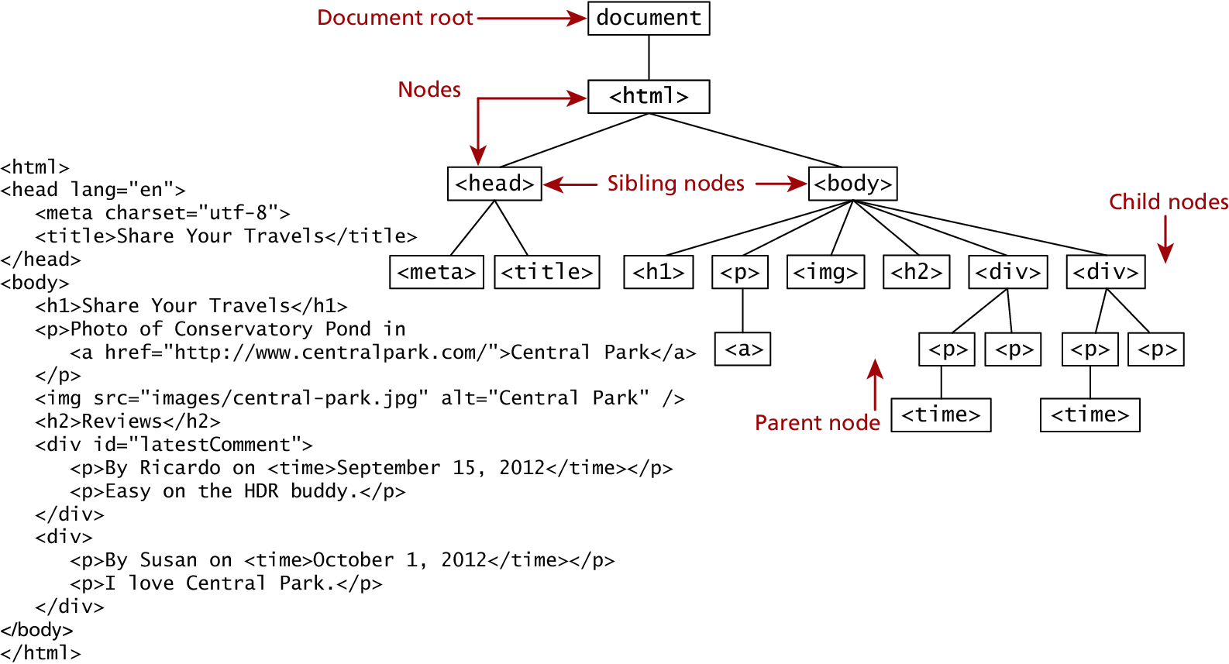
The DOM
The Document Object Model(DOM) is the objects that make up a web page. This tree structure is formally called the DOM Tree with the root, or topmost object called the Document Root.

Slide 21
DOM Nodes
In the DOM, each element within the HTML document is called a node. If the DOM is a
tree, then each node is an individual branch.
There are:
element nodes,
text nodes, and
attribute nodes
All nodes in the DOM share a common set of properties and methods.

Slide 22
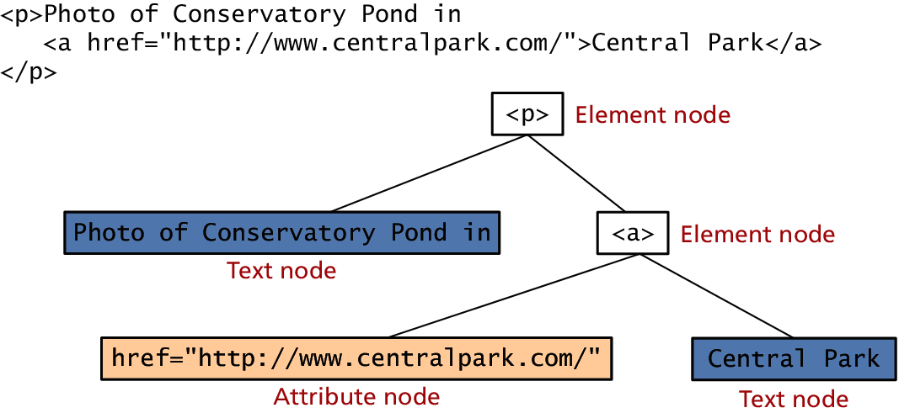
DOM Nodes
Element, text and attribute nodes

Slide 23
DOM Nodes
Essential Node Object properties
Property | Description
attributes | Collection of node attributes
childNodes | A Node List of child nodes for this node
firstChild | First child node of this node.
lastChild | Last child of this node.
nextSibling | Next sibling node for this node.
nodeName | Name of the node
nodeType | Type of the node
nodeValue | Value of the node
parentNode | Parent node for this node.
previousSibling | Previous sibling node for this node.

Slide 24
Document Object
The DOM document object is the root JavaScript object representing the entire HTML document.
It contains some properties and methods that we will use extensively in our development and is globally accessible as document.
// specify the doctype, for example html
var a = document.doctype.name;
// specify the page encoding, for example ISO-8859-1
var b = document.inputEncoding;

Slide 25


Document Object Document Object Methods
 | Method | Description
 | createAttribute() | Creates an attribute node
 | createElement() | Creates an element node
 | createTextNode() | Create a text node
 | getElementById(id) | Returns the element node whose id attribute matches the passed id parameter.
 | getElementsByTagNa me(name) | Returns a nodeList of elements whose tag name matches the passed name parameter.

Slide 26
Create Attributes
CreateAttribute
function myFunction() {
var h1 = document.getElementsByTagName("H1")[0];
var att = document.createAttribute("class");
att.value = "democlass";
h1.setAttributeNode(att);
}
SetAttribute
function myFunction() {
document.getElementsByTagName("H1")[0].setAttribute("class", "democlass");
}
}

Slide 27
createElement
function myFunction() {
var btn = document.createElement("BUTTON");
btn.innerHTML = "CLICK ME";
btn.setAttribute("onClick", "mufunc()");
document.body.appendChild(btn);
}
function mufunc(){
var btn = document.getElementsByTagName("button")[0];
btn.style.backgroundColor="red“
}
createTextNode
function myFunction() {
var t = document.createTextNode("Hello World");
document.body.appendChild(t);
}

Slide 28
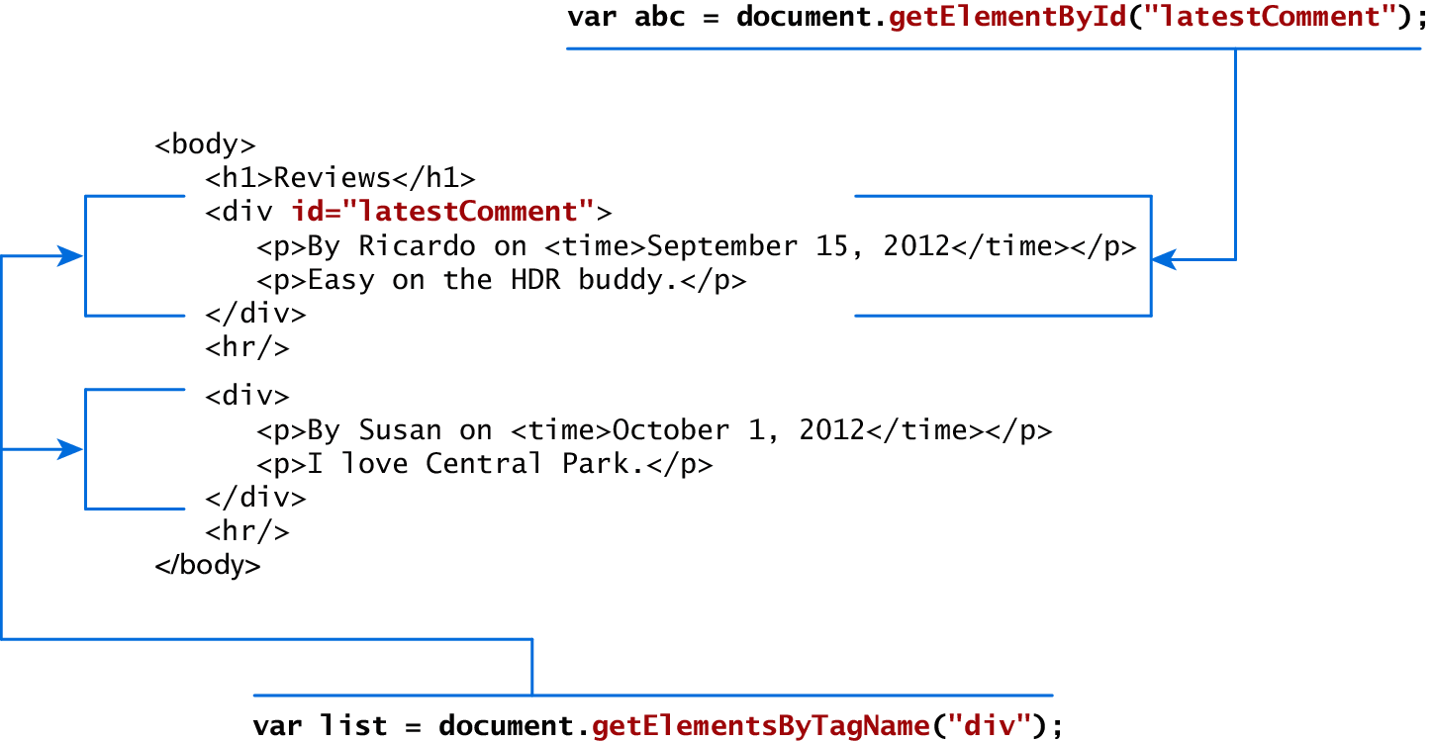
Accessing nodes
getElementById(), getElementsByTagName()

Slide 29
Element node Object
The type of object returned by the method document.getElementById() described in the previous section is an element node object.
This represents an HTML element in the hierarchy, contained between the opening <> and closing </> tags for this element.
can itself contain more elements

Slide 30
Element node Object
Essential Element Node Properties
Property | Description
className | The current value for the class attribute of this HTML element.
id | The current value for the id of this element.
innerHTML | Represents all the things inside of the tags. This can be read or written to and is the primary way which we update particular div's using JS.
style | The style attribute of an element. We can read and modify this property.
tagName | The tag name for the element.

Slide 31
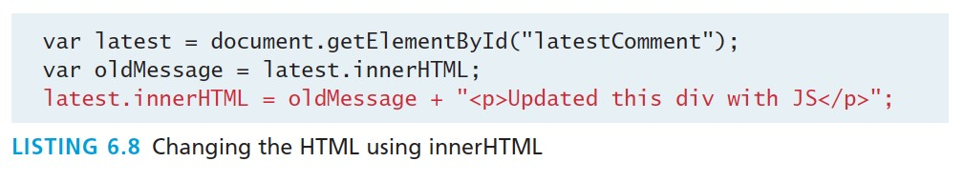
Modifying a DOM element
The document.write() method is used to create output to the HTML page from JavaScript. The modern JavaScript programmer will want to write to the HTML page, but in a particular location, not always at the bottom
Using the DOM document and HTML DOM element objects, we can do exactly that using the innerHTML property

Slide 32
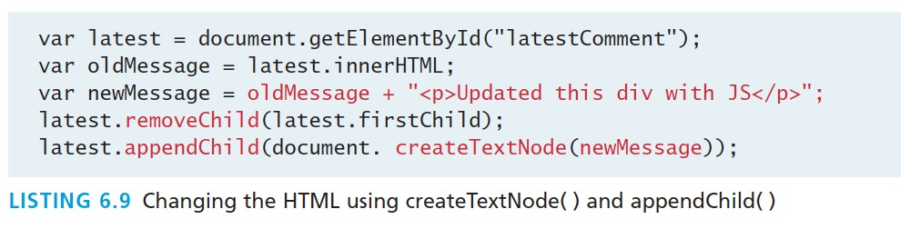
Modifying a DOM element
Although the innerHTML technique works well (and is very fast), there is a more verbose technique available to us that builds output using the DOM.
DOM functions createTextNode(), removeChild(), and appendChild() allow us to modify an element in a more rigorous way

Slide 33
Changing an element’s style
We can add or remove any style using the style or className property of the Element node.
Its usage is shown below to change a node’s background color and add a three-pixel border. var commentTag = document.getElementById("specificTag"); commentTag.style.backgroundColour = "#FFFF00"; commentTag.style.borderWidth="3px";

Slide 34
Changing an element’s style
The className property is normally a better choice, because it allows the styles to be created outside the code, and thus be better accessible to designers.
var commentTag = document.getElementById("specificTag"); commentTag.className = "someClassName";
HTML5 introduces the classList element, which allows you to add, remove, or toggle a CSS class on an element.
label.classList.addClass("someClassName");

Slide 35
More Properties
Property | Description | Tags
href | The href attribute used in a tags to specify a URL to link to. | a
name | The name property is a bookmark to identify this tag. Unlike id which is available to all tags, name is limited to certain form related tags. | a, input, textarea, form
src | Links to an external URL that should be loaded into the page (as opposed to href which is a link to follow when clicked) | img, input, iframe, script
value | The value is related to the value attribute of input tags. Often the value of an input field is user defined, and we use value to get that user input. | Input, textarea, submit

Slide 36
JavaScript Events

Slide 37
JavaScript Events
A JavaScript event is an action that can be detected by JavaScript.
We say then that an event is triggered and then it can be caught by JavaScript functions, which then do something in response.

Slide 38
JavaScript Events
In the original JavaScript world, events could be specified right in the HTML markup with
hooks to the JavaScript code (and still can).
As more powerful frameworks were developed, and website design and best practices were refined, this original mechanism was supplanted by the listener approach.

Slide 39
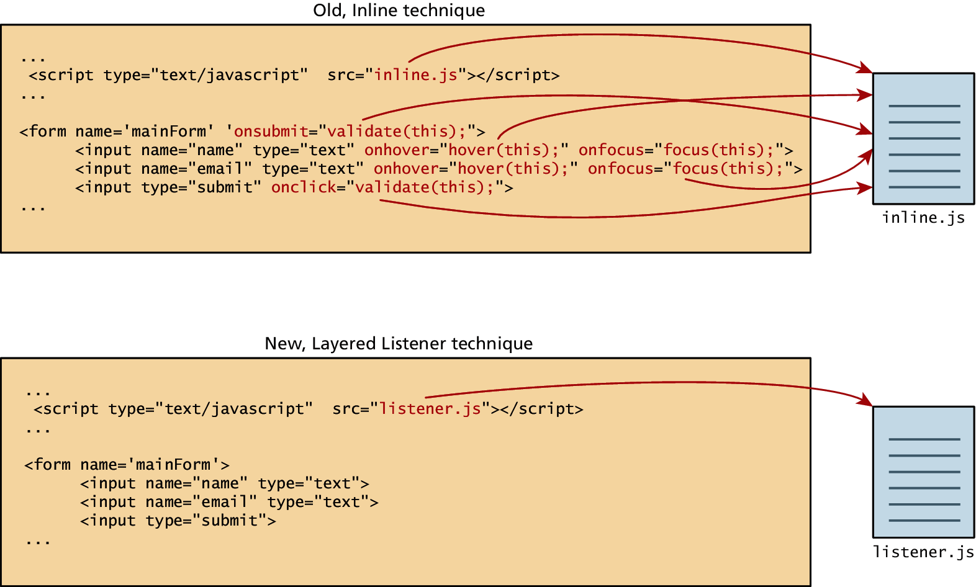
JavaScript Events
Two approaches

Slide 40
Inline Event Handler Approach
For example, if you wanted an alert to pop-up when clicking a <div> you might program:
<div id="example1" onclick="alert('hello')">Click for pop-up</div>
The problem with this type of programming is that the HTML markup and the corresponding JavaScript logic are woven together. It does not make use of layers; that is, it does not separate content from behavior.

Slide 41
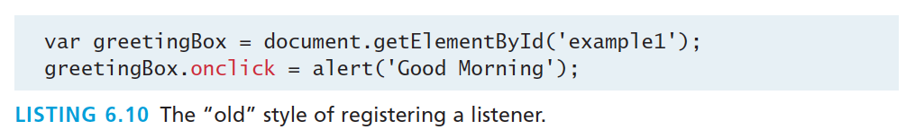
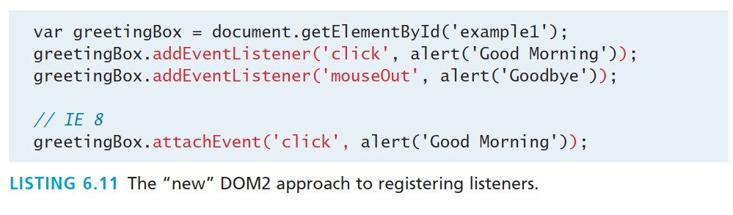
Listener Approach
Two ways to set up listeners

Slide 42
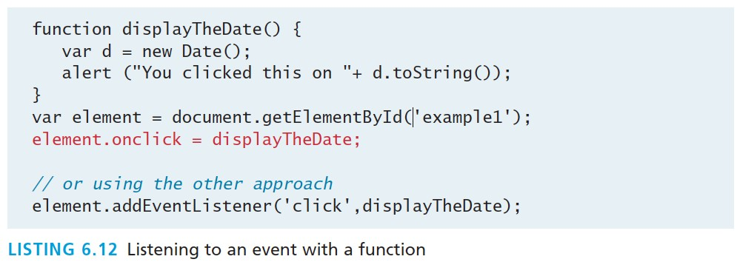
Listener Approach
Using functions
What if we wanted to do something more elaborate when an event is triggered? In such a case,
the behavior would have to be encapsulated within a function, as shown in Listing 6.12.

Slide 43
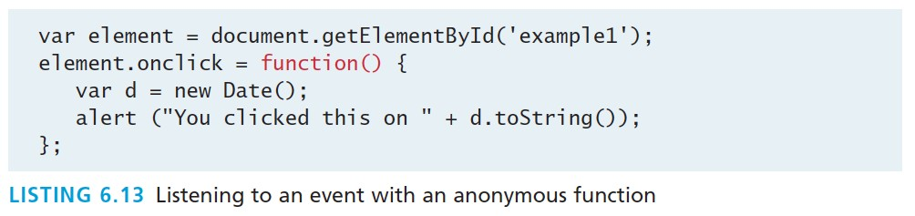
Listener Approach
Anonymous functions
An alternative to that shown in Listing 6.12 is to use an anonymous function (that is, one without a name), as shown in Listing 6.13.

Slide 44
Event Object
No matter which type of event we encounter, they are all DOM event objects and the event handlers associated with them can access and manipulate them. Typically we see the events passed to the function handler as a parameter named e.
function someHandler(e) {
// e is the event that triggered this handler.
}

Slide 45
Event Object
Bubbles. If an event’s bubbles property is set to true then there must be an event handler in place to handle the event or it will bubble up to its parent and trigger an event handler there.
Cancelable. The Cancelable property is also a Boolean value that indicates
whether or not the event can be cancelled.
preventDefault. A cancelable default action for an event can be stopped using the preventDefault() method in the next slide

Slide 46
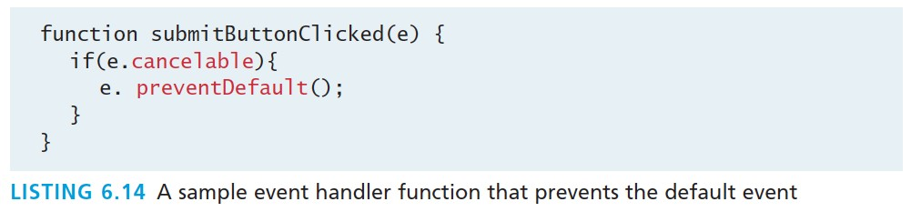
Event Object
Prevent the default behaviour

Slide 47
Event Types
There are several classes of event, with several types of event within each class specified by the W3C:
mouse events
keyboard events
form events
frame events

Slide 48
Mouse events
Event | Description
onclick | The mouse was clicked on an element
ondblclick | The mouse was double clicked on an element
onmousedown | The mouse was pressed down over an element
onmouseup | The mouse was released over an element
onmouseover | The mouse was moved (not clicked) over an element
onmouseout | The mouse was moved off of an element
onmousemove | The mouse was moved while over an element

Slide 49
Keyboard events
Event | Description
onkeydown | The user is pressing a key (this happens first)
onkeypress | The user presses a key (this happens after onkeydown)
onkeyup | The user releases a key that was down (this happens last)

Slide 50
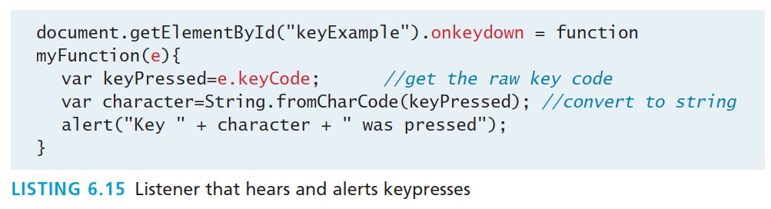
Keyboard events
Example
<input type="text" id="keyExample">
The input box above, for example, could be listened to and each key pressed echoed back to the user as an alert as shown in Listing 6.15.

Slide 51
Form Events
Event | Description
onblur | A form element has lost focus (that is, control has moved to a different element, perhaps due to a click or Tab key press.
onchange | Some <input>, <textarea> or <select> field had their value change. This could mean the user typed something, or selected a new choice.
onfocus | Complementing the onblur event, this is triggered when an element gets focus (the user clicks in the field or tabs to it)
onreset | HTML forms have the ability to be reset. This event is triggered when that happens.
onselect | When the users selects some text. This is often used to try and prevent copy/paste.
onsubmit | When the form is submitted this event is triggered. We can do some pre- validation when the user submits the form in JavaScript before sending the data on to the server.

Slide 52
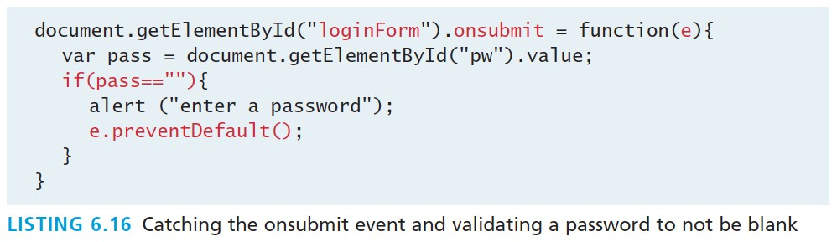
Form Events
Example

Slide 53
Frame Events
Frame events are the events related to the browser frame that contains your web page.
The most important event is the onload event, which tells us an object is loaded and therefore ready to work with. If the code attempts to set up a listener on this not-yet- loaded <div>, then an error will be triggered.
window.onload= function(){
//all JavaScript initialization here.
}

Slide 54
Frame Events
Event | Description
onabort | An object was stopped from loading
onerror | An object or image did not properly load
onload | When a document or object has been loaded
onresize | The document view was resized
onscroll | The document view was scrolled
onunload | The document has unloaded

Slide 55
Forms

Slide 56
Validating Forms
Writing code to prevalidate forms on the client side will reduce the number of incorrect submissions, thereby reducing server load.
There are a number of common validation activities including email validation, number validation, and data validation.

Slide 57
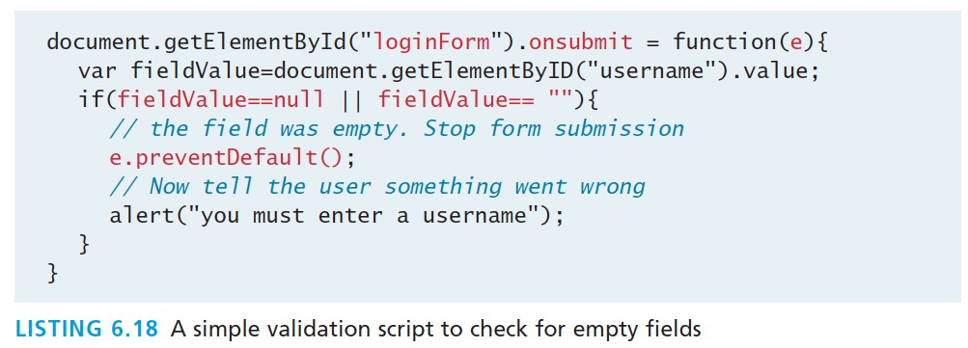
Validating Forms
Empty field

Slide 58
Validating Forms
If you want to ensure a checkbox is ticked, use code like that below.
var inputField=document.getElementByID("license"); if (inputField.type=="checkbox"){
if (inputField.checked)
//Now we know the box is checked
}

Slide 59
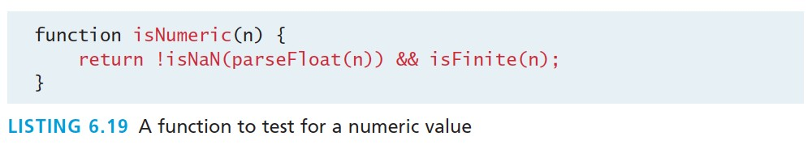
Validating Forms
Number Validation

Slide 60
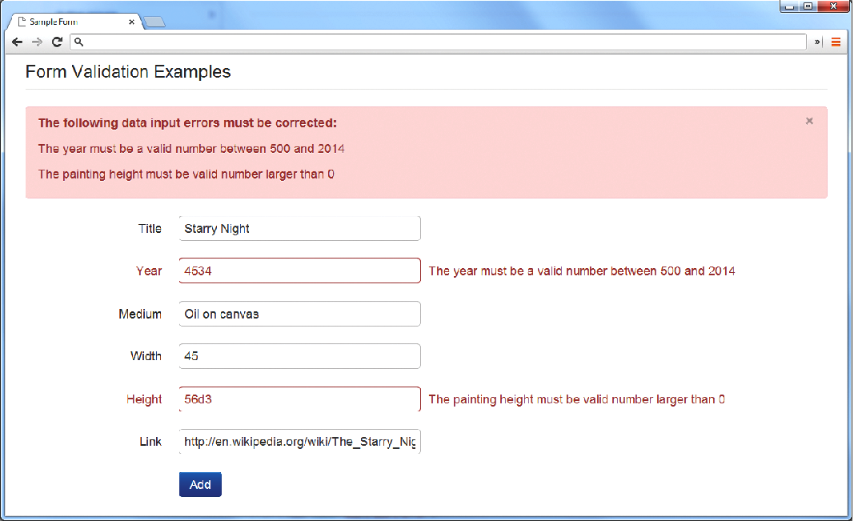
Notifying the User

Slide 61
Types of Input Validation
Required information. Some data fields just cannot be left empty. For instance, the principal name of things or people is usually a required field. Other fields such as emails, phones, or passwords are typically required values.
Correct data type. Some input fields must follow the rules for its data type in order to be considered valid.
Correct format. Some information, such as postal codes, credit card numbers, and social security numbers have to follow certain pattern rules.

Slide 62
Types of Input Validation
Comparison. Perhaps the most common example of this type of validation is entering passwords: most sites require the user to enter the password twice to ensure the two entered values are identical.
Range check. Information such as numbers and dates have infinite possible values. However, most systems need numbers and dates to fall within realistic ranges.
Custom. Some validations are more complex and are unique to a particular application

Slide 63
Notifying the User
What is the problem? Users do not want to read lengthy messages to determine what needs to be changed. They need to receive a visually clear and textually concise message.
Where is the problem? Some type of error indication should be located near the field that generated the problem.
If appropriate, how do I fix it? For instance, don’t just tell the user that a date is in the wrong format, tell him or her what format you are expecting, such as “The date should be in yy/mm/dd format.”

Slide 64
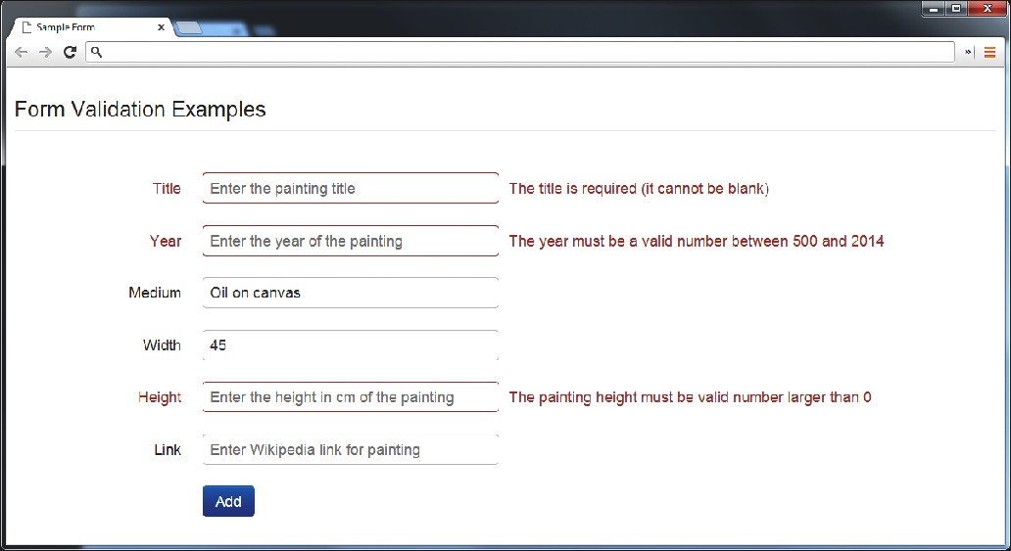
Another illustrative examples

Slide 65
How to reduce validation errors
Using pop-up JavaScript alert (or other popup) messages
Provide textual hints to the user on the form itself
Using tool tips or pop-overs to display context-sensitive help about the expected input
a JavaScript-based mask

Slide 66
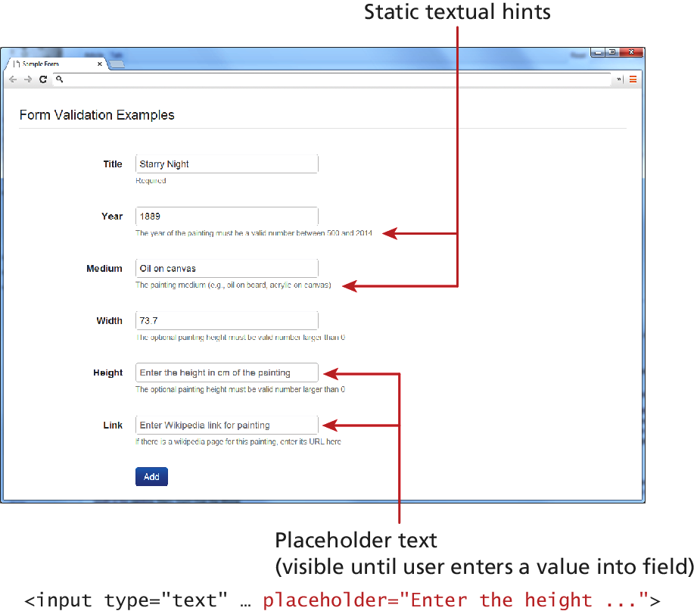
How to reduce validation errors

Slide 67
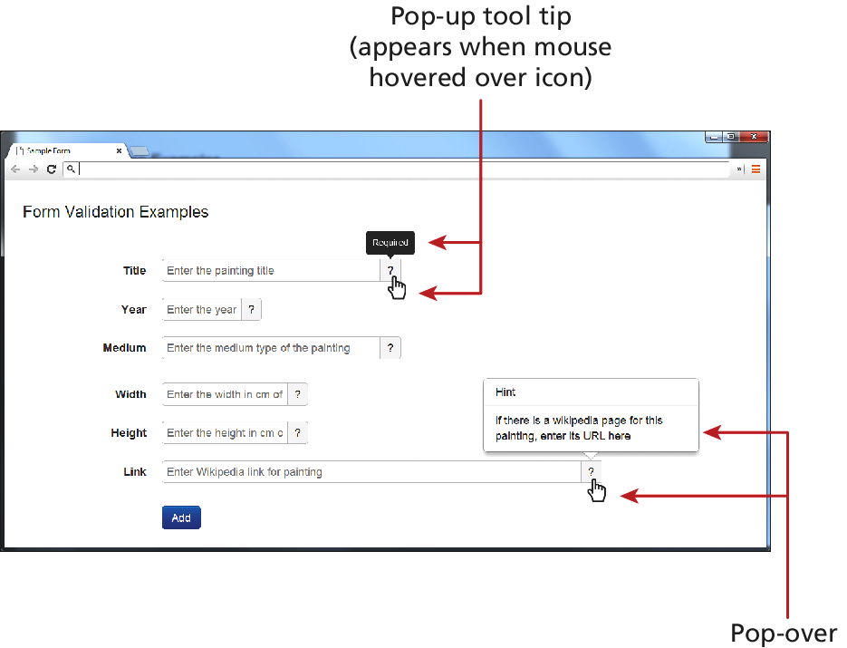
How to reduce validation errors

Slide 68
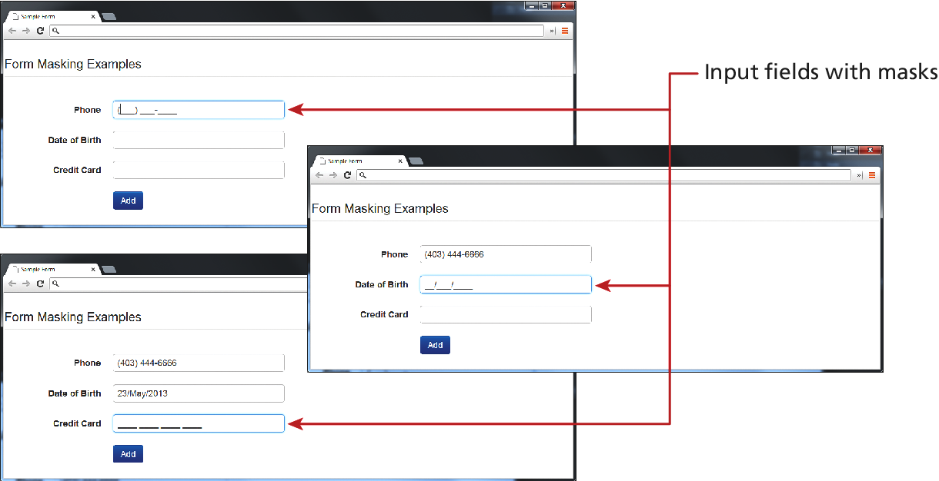
How to reduce validation errors

Slide 69
How to reduce validation errors
Many user input errors can be eliminated by choosing a better data entry type than the standard
<input type="text">
If you need to get a date from the user, use the HTML5
<input type="date”>
If you need a number, use the HTML5
<input type="number">

Slide 70
Submitting Forms
Submitting a form using JavaScript requires having a node variable for the form element. Once the variable, say, formExample is acquired, one can simply call the submit() method:
var formExample = document.getElementById("loginForm"); formExample.submit();
This is often done in conjunction with calling preventDefault() on the onsubmit event.

